Slide 1




Reclaiming the Engineering in Model-Based Systems Engineering:
Refocusing MBSE on Practical System Engineering Outcomes
International Council on Systems Engineering
A better world through a systems approach
Eric Alexander
Alan Bouchard
Kiffin Bryan
Megan Turner
INCOSE Great Plains Chapter Meeting

Slide 2
What this session is really about
MBSE success requires a return to system engineering-first thinking.
We risk replacing document-based anti-patterns with model-based ones.
We propose practical strategies to realign modeling with engineering rigor.

Slide 3
Agenda
The Problem
The Gap
The Solution
The Outcome

Slide 4
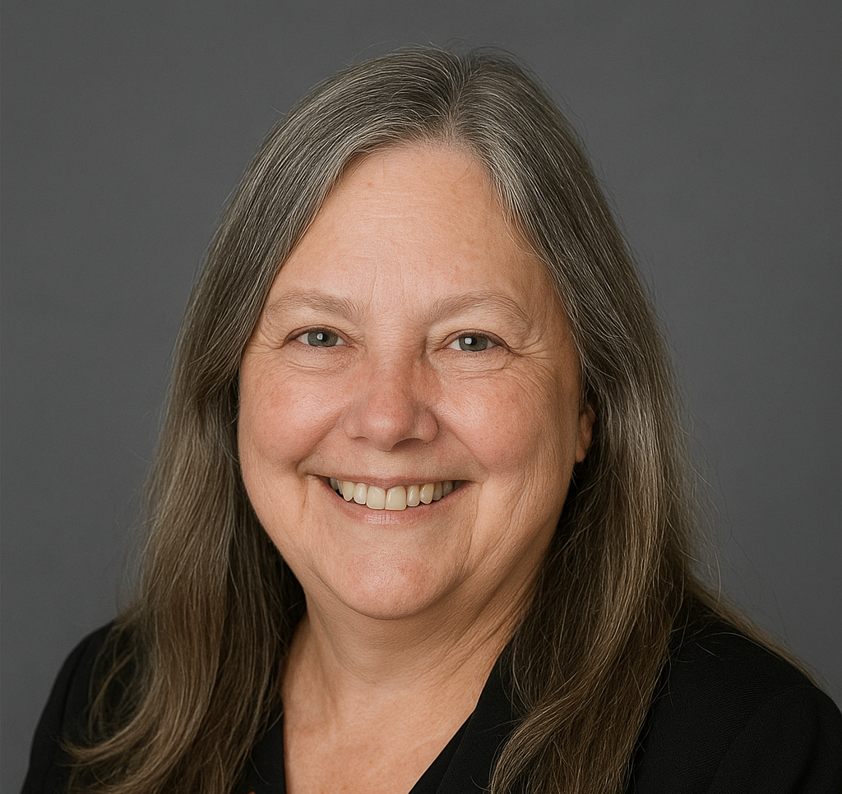

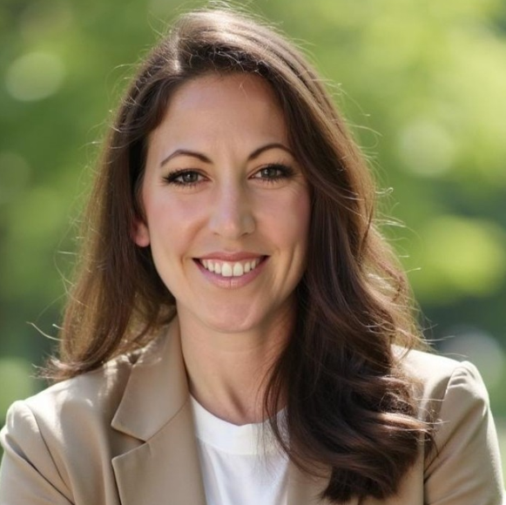

The Experienced Practitioner
The Next-Generation Modeler
The Program Reality Check
Me
Kiffin Bryan, ESEP
Alan Bouchard
Megan Turner
Eric Alexander, CSEP
30-year systems engineering professional dedicated to anchoring MBSE in practical, outcome-driven engineering. I specialize in connecting legacy SE discipline with modern modeling approaches.
19-year defense industry veteran with 10 years in systems engineering. I serve as a 'keystone' bridging traditional SE principles into modern models through my work and mentorship.
5+ years in defense programs through MBSE and digital transformation. Leads modeling for ground combat vehicle and unmanned air systems. Applies SysML, PLE, and targeted training.
At Sabel Systems, I serve as a Digital Fellow focused on digital systems engineering, lifecycle decision infrastructure, and the practical application of digital engineering across defense acquisition programs.

Slide 5
Acknowledge and Understand the Problem

Slide 6
Reclaiming the Engineering in MBSE
The Evolution of Systems Engineering
From Documents to Models:
  Industry needed a strategic evolution from document-centric processes to model based approaches
    Modeling addresses real limitations of document-based approaches (increasing complexity, difficulty maintaining traceability, etc.)
The V-Model Foundation:
  Traditional SE centered on answering two critical questions:
    “Are you building the right thing?” (Validation)
    “Are you building it correctly?” (Verification)
The Core Engineering Value at Risk:
  What these principles provided that we must preserve:
    Demonstrable evidence that stakeholder needs were understood
    Clear proof that the system was thoroughly verified
    Shared understanding across disciplines
    Engineering transparency throughout the lifecycle
Requirements
Test
Validation
Verification
Implementation
Notes:
Begin with personal perspective as someone who started in traditional document-based SE.
Briefly explain how the V-model provided clear frameworks for ensuring engineering rigor.
Emphasize how these values became diluted in the transition to MBSE

Slide 7
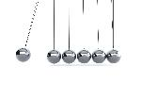
Reclaiming the Engineering in MBSE
The Overcorrection Problem
The Pendulum Effect:
  In solving document-based challenges, we've swung too far in the opposite direction
  MBSE implementation has often overemphasized modeling techniques at the expense of engineering fundamentals
Syntax Over Substance:
  Focus shifted to model perfection rather than engineering outcomes
  SysML compliance and diagram correctness is sometimes valued more than engineering rigor
  Models becoming ends in themselves rather than means to better engineering
Unintended Consequences:
  Engineering decisions obscured by modeling complexity
  Stakeholders struggle to see evidence that we're "building the right thing correctly"
  Documentation of verification and validation less transparent in complex models
  Traditional engineering rigor diluted in pursuit of modeling sophistication
  Reduction in the proposed return on investment of SE
Notes:
Emphasize this isn't a criticism of MBSE itself, but how it's sometimes implemented.
Use the pendulum analogy to show that overcorrections are natural in technology evolution.
Discuss an example of how model perfection sometimes takes precedence over addressing fundamental engineering questions.
The goal is to help the audience recognize this pattern in their own organizations.

Slide 8
Reclaiming the Engineering in MBSE
The Generational Gap
Skills Imbalance:
  Junior engineers often highly skilled in modeling but disconnected from SE fundamentals
  Technically proficient in SysML syntax but may lack deeper understanding of engineering principles
  Model creation expertise doesn't always translate to engineering judgment
Knowledge Transfer Challenges:
  Traditional engineering wisdom not effectively codified in modeling practices
  Experiential understanding of validation and verification principles difficult to capture in SysML
  The "why" behind engineering decisions gets lost in the transition to model-based approaches
Real-world Consequences:
  Engineering gaps sometimes masked by sophisticated models where verification deficiencies are obscured rather than addressed
  Stakeholders receive impressive visualizations but may miss critical engineering insights
  Decision-making increasingly driven by what can be modeled rather than what should be verified
Notes:
Share personal anecdote about customers requesting modeling to mask verification deficiencies would fit well.
Emphasize that this isn't about criticizing junior engineers but about how our tools are introducing systemic failures in knowledge transfer.
Clarify we need to ensure fundamental engineering principles are maintained alongside modeling skills.
Verification gaps can be concealed by sophisticated models, this ultimately undermines the engineering integrity we're trying to preserve.

Slide 9
Reclaiming the Engineering in MBSE
The Core Challenges
The Central Questions:
  Are we upholding rigorous engineering standards while advancing modeling capabilities?
  Can we confidently demonstrate to stakeholders that we are "building the right thing correctly"?
  Are we equipping the next generation to maintain these standards?
Process vs. Purpose:
  When modeling becomes the goal rather than the means to sound engineering
  Completing model artifacts sometimes prioritized over engineering value they provide
  Verification and validation activities adapted to fit modeling constraints rather than engineering needs
Metrics Misalignment:
  Measuring model completeness instead of engineering soundness
  Success defined by model maturity rather than verification coverage
  Quality metrics focused on SysML compliance rather than requirements verification
  Risk of creating "beautiful models of the wrong system"
Notes:
There is a fundamental tension at the heart of modern MBSE practice.
This is not about choosing between approaches but about integrating them effectively.
The point isn't that modeling is wrong, but that we need to ensure it serves its true purpose.
Question directly to the audience
- Can you confidently say your models effectively demonstrate to stakeholders that they are building the right thing and building it correctly?

Slide 10
Common Scenarios and Strategies to Overcome Model-Focus

Slide 11

Common Anti-Patterns: When Modelers Masquerade as Systems Engineers
Model Focus vs. Product Focus
Problem: High-value programs “Digital Engineering Programs” with aggressive timelines often lead companies to recruit for tool proficiency (e.g., SysML modeling) over engineering depth as they staff up the program(s).
Results in:
  Teams of “diagrammers” vs. engineers
  Models treated as deliverables vs. enablers
  Silos that weaken collaboration with SMEs and domain experts
  Reinforced myths that MBSE is “extra” or “inefficient”
Impact:
  Systems engineering rigor is diluted across the entire company
  Design decisions are unsupported by MBSE, trust in the model is depleted
  Program risk increases, complexity not understood
  MBSE adoption slows or stalls, gives MBSE a bad-rap
"A fool with a tool is still a fool“ - Grady Booch
Avoid this anti-pattern at all costs! Classically trained Systems Engineers can be taught SysML much quicker than a modeler can become an effective systems engineer.

Slide 12
The True Role of Models in Engineering
Models must be:
  A means to an end, not the end itself
  Integrated with SME inputs and authoritative data
  Structured to inform design, verify decisions, and align stakeholder intent
  Scaled to support production, sustainment, and change over time
Well-formed models should:
  Encode behavior, performance, interfaces
  Drive requirement validation and risk mitigation
  Drive architecture decisions before design decisions, reducing integration risk and rework
  Support modular reuse, obsolescence tracking, and traceability

Slide 13

The Anatomy of a High Performance MBSE Team
Balancing the right ingredients to maintain a product-focus mindset
PMP
CSEP
OCSMP
Program Manager
Lead Systems Engineer
Systems Modeling SME
+
A blend of program management, SE leadership, and systems modeling expertise is key to maintain in a high performing systems engineering team that is focused on delivering products, not just models.
Each of these roles brings something unique to the table, and together they form a product development powerhouse.
  PM: “Lets figure out how to add maximum value to the customer, within cost and schedule constraints”
  SE: “Lets figure out early on how all the pieces fit together to reduce risk on the program and deliver a system that meets its requirements”
  Model SME: “Let’s use the power of integrated systems models to reduce complexity and enhance systems engineering rigor on the program.’
  AI: “let me do things computers are best at, enabling you humans do your higher-level thinking and complex socio-technical problem solving”
Harness the power of AI today to offload and automate low-complexity model building tasks, or else continue to pay the initially high price of MBSE adoption
Maintain an organizational pattern for blending these skillsets on every project, regardless of the size. If an individual possesses these three skillsets, invest and replicate them!

Slide 14
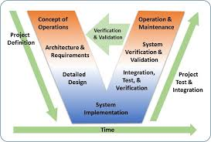
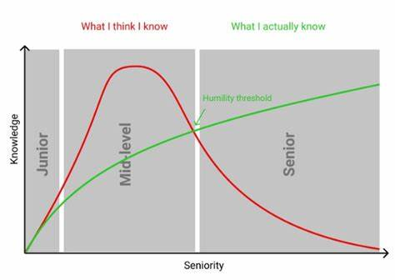
Practical Strategies to Rebalance Teams
Maturity over Time
What to do with an influx of modelers in the organization?
Senior SE
Junior SE
Pair “modelers” with veteran systems engineers
Junior / entry SE’s should start on the v&v side of the Vee model before trying to produce abstract systems architecture concepts and write requirements
Use an SE skills matrix to guide team composition and career development
Map technical experience to lifecycle phases, not just tool fluency
Implement internal mentorship, knowledge management, and onboarding frameworks
Understand that MBSE familiarity ≠ SE passion—map employees’ intentions to roles
Effective MBSE teams blend technical modeling with deep systems thinking—match skills to lifecycle needs, foster mentorship, and align roles with passion, not just tool use.

Slide 15

Leadership Actions for Sustaining Product-Focused MBSE
Keep the product the north star—models are only valuable when they contribute to user success
Define what good looks like—via architecture reviews, tradespaces evaluations, validation threads
Create a culture of engineering-first, model-enabled thinking
Invest in cross-training, not just tool training
Treat AI as an accelerant, not a replacement for systems engineers

Slide 16
Model-Based
Practical System Engineering
Outcomes
Some Practical Examples
Model Based SEMP
Technical Reviews
Processes and more...

Slide 17
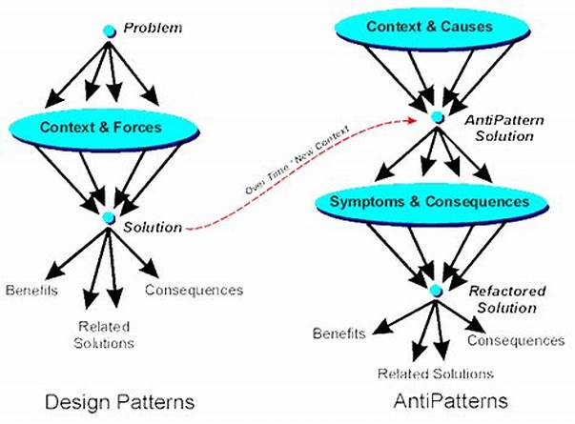
Current State of Practice: Static, Sidelined SEMP
Challenge: The Systems Engineering Management Plan (SEMP) is often written early to fulfill contractual requirements and then set aside, losing relevance as the program evolves.
MBSE Solution: Embeds the SEMP directly into the model, transforming it into a living, model-driven guide that stays aligned with real-time engineering activities and decisions.
Model Based System Engineering Management Plan (SEMP)

Slide 18
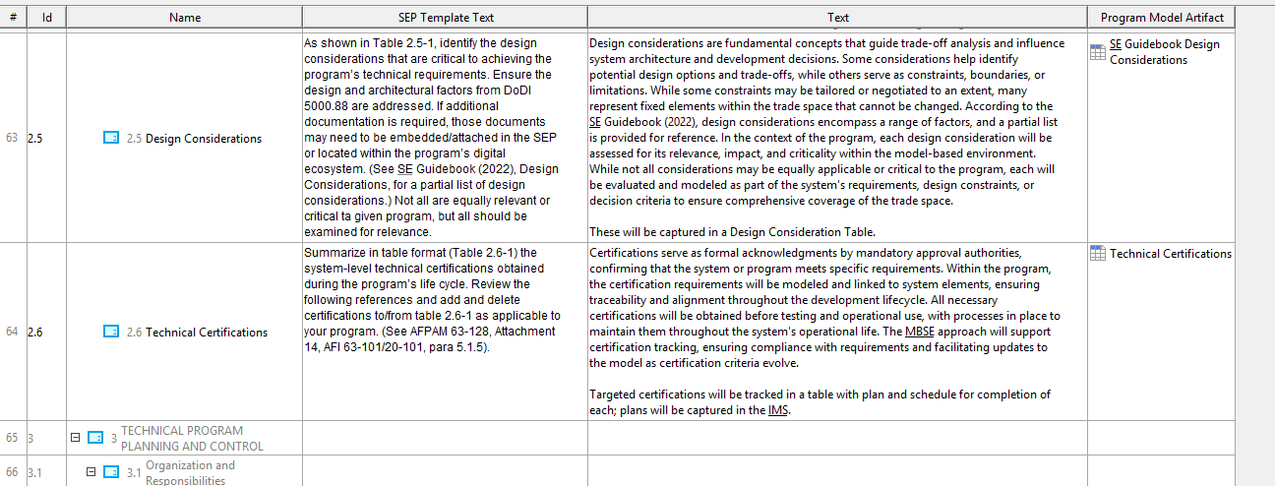
SEMP
Alignment Isn’t Optional—It’s Modeled

Slide 19
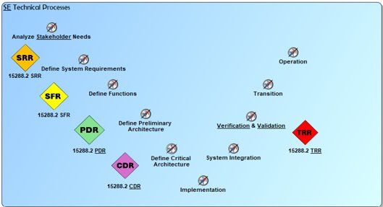
Current State of Practice
Engineering Models (CAD, ECAD, Simulation):
Developed in isolation for specific, narrow purposes
Shared as screenshots or exported documents, not as live data
Limited or no traceability to related requirements, behavior, or architecture
Not integrated into a broader system model or digital thread
Data Sharing & Review Prep:
Shared via emails, PDFs, printouts, or Teams messages
Manual effort introduces complexity and risk of inconsistency
Requires significant time to compile and format review materials
Lacks centralized configuration management, leading to version confusion
Technical Milestone Reviews

Slide 20
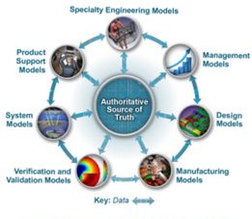

Fragmented Data Across Tools and Formats
Challenge: Artifacts are often dispersed across multiple documents and systems, leading to inconsistencies and duplication.
MBSE Solution: Establishes a single source of truth by centralizing information within a unified model, ensuring data integrity and coherence.

Slide 21
Visibility into Milestone Readiness
Challenge: Tracking progress toward milestone completion is often ad hoc and lacks a unified dashboard.
MBSE Solution: Offers built-in mechanisms to track artifact maturity and review status, providing clear insight into milestone readiness.

Slide 22
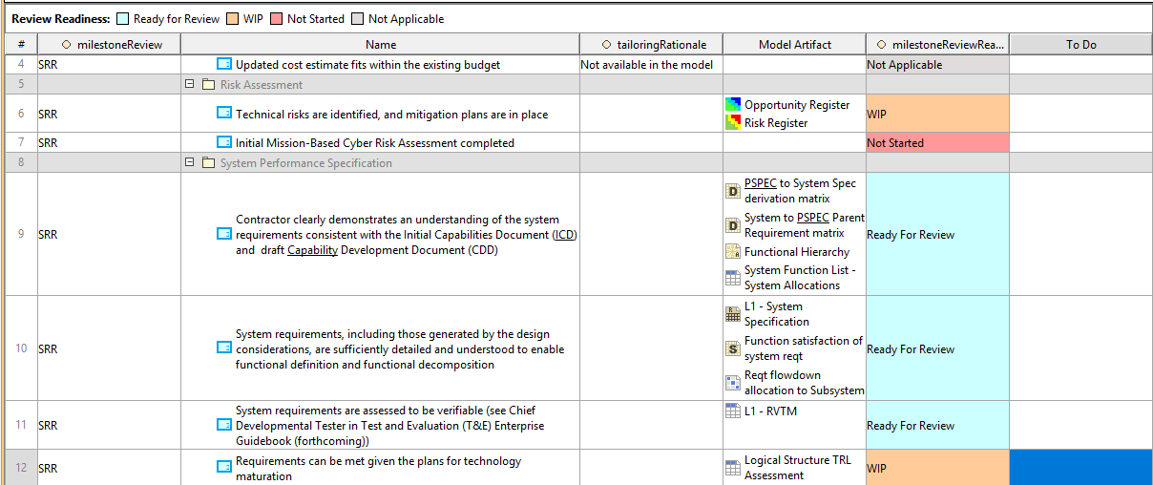
Path to SRR
Readiness Isn’t a Guess—It’s in the Model

Slide 23
Updates and Reviews
Challenge: Late-stage changes are difficult to incorporate without rework and risk of error.
MBSE Solution: Facilitates last-minute updates within the model, instantly reflecting changes across related views and artifacts.
MBSE Solution: Supports automated VTL exports for read-ahead packages, enabling stakeholders to engage with accurate, up-to-date information before the formal review.

Slide 24
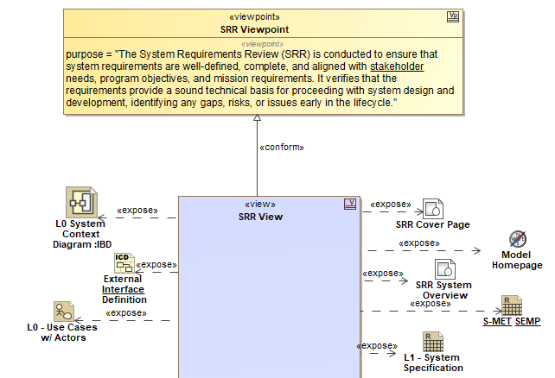
SRR Read-Ahead
From Model to Slide Deck—In One Click with VTL

Slide 25
Address Real-Time Review Questions Effectively
Challenge: Presenters and Reviewers may lack access to the full context or source artifacts during discussions.
MBSE Solution: Provides access to all linked model artifacts in real time, allowing reviewers to trace requirements, behaviors, and structures on the spot.

Slide 26
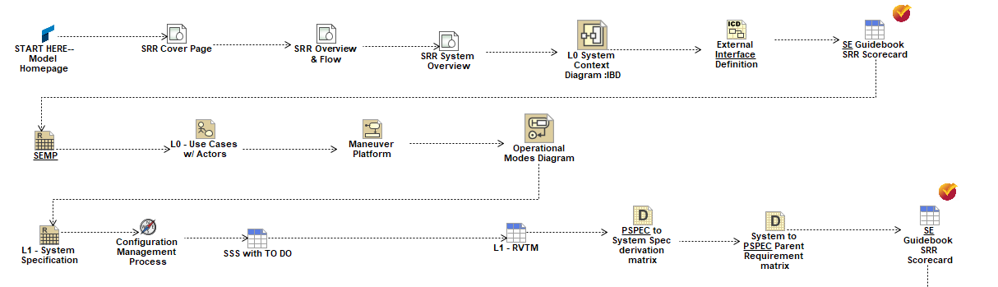
SRR Presentation
Run the Review from the Source—The Model Is the Brief

Slide 27
Review Record-Keeping
Challenge: Critical review metadata (e.g., dates, attendees, decisions) is often captured separately from technical artifacts, risking loss or misalignment.
MBSE Solution: The model can act as the single authoritative source for milestone review data—including review date, attendee list, and voting records—ensuring traceability and audit readiness.

Slide 28
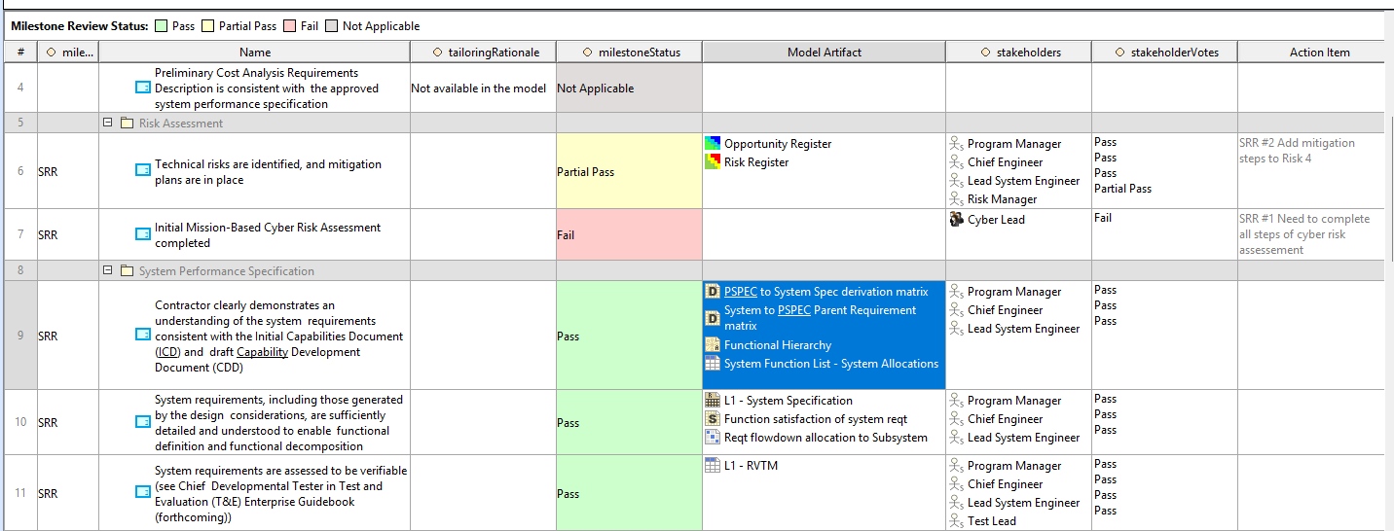
SRR Scorecard
Real-Time Satus. Executive Confidence

Slide 29
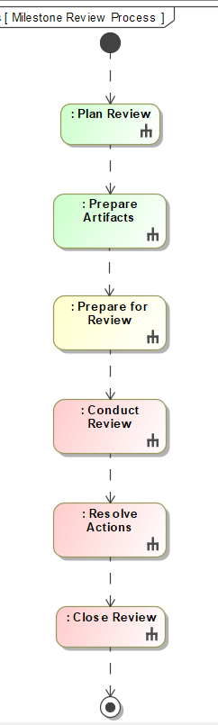
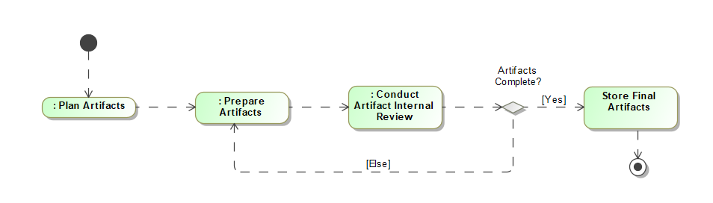
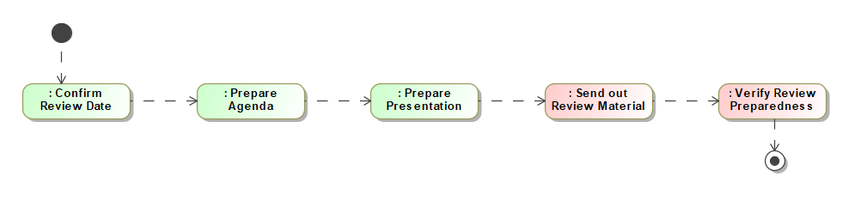
Capture Processes in the model
The opportunities are limitless...

Slide 30

Bridging the Knowledge Gap
Aligning Modeling Practices with Core Systems Engineering Principles

Slide 31
Identifying the Knowledge Gap
Modeling proficiency is rising — but often lacks foundational Systems Engineering (SE) principles.
Mastery of SysML syntax ≠ Sound engineering judgment or decision-making.
V-model fundamentals are being overlooked:
  Are we solving the right problem?
  ️ Are we solving the problem the right way?
Notes:
As modeling skills have expanded across the industry, we’ve seen an unintended gap emerge.
Many practitioners have strong SysML proficiency — but lack foundational systems engineering judgment.
This disconnect pulls focus away from the V-model’s core questions: Are we building the right thing? Are we building it correctly?
If we lose sight of those, even the most impressive model can't guarantee mission success.

Slide 32
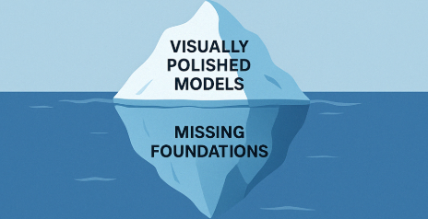
How the Gap Manifests
Requirements lack validation traceability, undermining testability and stakeholder confidence
Verification activities are adapted to fit the model
Visually polished models that fail technical milestone reviews
Stakeholders impressed by visuals but left unclear on system completeness
Notes:
We can see this gap in real-world program execution.
Requirements may look complete in the model but aren't traceable or verifiable.
Verification activities sometimes get distorted to fit modeling constraints rather than system needs.
Stakeholders might be impressed by polished diagrams but leave technical reviews unclear whether the system is truly complete and correct.
Beautiful models can still hide engineering risks if SE fundamentals aren't maintained.

Slide 33
Closing the Gap: Practical Strategies
Build SE Fluency – Train modelers in foundational Systems Engineering: V&V, traceability, lifecycle rigor, and system thinking
Embed SE Artifacts into the Model – Include model-based SEMPs, requirement trace matrices, and verification frameworks
Synchronize Models with Reviews – Align modeling progress with technical milestone reviews and readiness assessments
Encourage Professional Certification – Support CSEP/ASEP pursuit to reinforce standards and elevate practitioner credibility
Notes:
So how do we close this gap?
First, we must teach core SE principles alongside modeling skills — emphasizing traceability, lifecycle rigor, and verification.
Second, we embed key SE artifacts directly into the model: model-based SEMPs, verification matrices, review packages.
Third, we align modeling milestones to real technical readiness milestones — not arbitrary model maturity.
And finally, we encourage certifications like CSEP, reinforcing the engineering backbone behind the modeling work.

Slide 34

Strengthening the Next Generation
Bridge the Gap with Mentorship – Pair junior modelers with experienced systems engineers for guided, hands-on learning
Use Skills Matrices for Intentional Growth – Align development plans with core SE competencies and modeling proficiency
Institutionalize SE Wisdom – Create structured mentorship programs focused on engineering tradeoffs and decision-making
Promote Experiential Learning – Involve junior staff in real-world challenges: risk analysis, trade studies, and requirements development
Notes:
This effort must start with how we grow our teams.
Pair junior modelers with seasoned systems engineers to pass down decision-making judgment, not just syntax knowledge.
Use skills matrices to track growth and expose engineers to all phases of the lifecycle.
Formal mentorship programs and opportunities like INCOSE working groups will build not just modelers — but future system engineering leaders.

Slide 35
From Mentorship to Mastery
Academic Programs Supporting INCOSE Certification
Stevens Institute of Technology
• Graduate Certificate — 12 credits
• Online, offered year-round
University of Detroit Mercy
• Graduate Certificate — 15 credits
• Fully online
University of Michigan
• Master’s in Systems Engineering & Design — 30 credits
• Hybrid / Online
Georgia Tech
• Professional Master’s in Applied SE — 33 credits
• Hybrid, cohort-based
Johns Hopkins University
• Part-time Certificate Program
• Online, flexible format

Slide 36
Final Thought: MBSE is Engineering
MBSE must reclaim its purpose: To enable better engineering decisions – not just better models
Models are tools, not the goal
Engineering outcomes remain the standard for success
Notes:
Ultimately, we must remember — MBSE is a tool, not the goal.
Its true purpose is to support better engineering decisions.
The measure of success isn't the perfection of the model — it's the quality and completeness of the engineered system.
By reclaiming the engineering at the heart of MBSE, we’ll deliver stronger outcomes, drive greater adoption, and prepare the next generation to build the right systems for the future.

Slide 37
"The purpose of models is not to fit the data but to sharpen the questions."
(Samuel Karlin, 1983)

